Slide 1
NexusWave
Network bonding technology

Slide 2
Unique SD-WAN technology
Centralized network orchestration
NexusWave is underpinned by SD-WAN technology providing seamless network bonding
The unique application of SD-WAN technology aggregates available capacity from GX Ka-band, LEO, LTE and L-band network underlays to maximise throughput and enable ‘always-on’ connectivity
TCP connections are maintained and accelerated regardless of underlay availability and performance
Traffic scheduling is handled by Smart Networking Protocol (SNP) – a proprietary transmission protocol, facilitating packet-by-packet intelligence & control, and mobility, providing optimised use of network underlays under changing link conditions
The result is a single, fast, bonded network with increased download and upload speed
Security
Network visibility
Improved performance for optimal end user experience
Always-on connectivity
Scalability
Flexibility

Slide 3
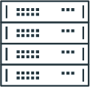
End-2-End architecture
Overlay network traffic is transported end-to-end over the available underlays
VESSEL
SHORE
CUSTOMER TRAFFIC
Overlays
Underlays
Global and redundant networks
Customer HQ
GX
AMER
Corporate LAN
Operational Traffic (OT) LAN
Crew LAN
Fleet Edge Retail
CDC
SDEP
SD-WAN Edge End Point (SEEP)
LEO
EMEA
SD-WAN Datacenter End Point (SDEP)
SD-WAN Datacenter End Point (SDEP)
LTE/ Cellular
L-BAND
APAC
CDC
WWW
SDEP
A global and redundant infrastructure setup provides resiliency and enables traffic to be handled as close to origin as possible to minimise latency
Traffic is encrypted and tunneled from the edge to the destination CDC
SD-WAN SEEP encapsulates, manages and steers traffic according to defined policies
SD-WAN SDEP decapsulates the received traffic at data centre before being routed to its onwards destination by the transport network
3

Slide 4
Dynamic management of traffic
Traffic is dynamically managed to support the fluctuating traffic demand on the vessel and the variable network availability and conditions
Through network bonding, multiple networks are combined to deliver higher speeds
In ports and close to coastal areas, mobile terrestrial networks (4G/5G) provide added capacity to boost the service, when included in the subscription plan
In hotspot areas, such as busy ports, or when line of sight is obscured, traffic demand will be served by multiple networks to deliver consistent end-user experience
In an event VSAT or LEO networks are unavailable, for example in adverse weather conditions in the middle of the ocean, L-Band will help ensure continuity of operational traffic
GX
LEO
LTE
L-BAND
CORP
OT
CREW
While in port and coastal areas, where line of sight issues and congestion can be a problem
GX
LEO
LTE
L-BAND
CORP
OT
CREW
GX
LEO
LTE
L-BAND
Deep sea with low to regular traffic demands
Deep sea with traffic burst demands
CORP
OT
CREW
In adverse weather conditions away from shore, L-Band will provide resilience to critical operational traffic
GX
LEO
LTE
L-BAND
CORP
OT
CREW

Slide 5
Packet steering
LEO
LTE
GEO
Leverages all links for single flow
Link is selected for each packet
More resilient to link failure
Increase application throughput - > sum of all networks
Increased network redundancy

Slide 6
Network security on the NexusWave platform
Encryption
DPI filtering
LEO
LTE
GEO
Edge DPI policy engine used to block Malware category (Reputation, Suspicious activity, etc.)
Encryption of your application data using AES256, similar to the encryption used by banks
Data splitting
ISP Internet edge firewall
LEO
LTE
ISP grade firewall at Internet demarcation
DDOS prevention - DDOS attempt stopped at the core network edge
GEO
Application receives a single, seamless connection
Security is enhanced with data split over networks
“Man-in-the-middle” attacks become very difficult, as data is scrambled when it goes through SD-WAN and is not travelling over only one link

Slide 7
Network segregation
Business, Operational and Crew networks
End2End encryption on all customer network’s traffic across all underlays
Closest MMP/POP routing, increased performance on Cloud and web applications hosted close to the region where traffic is landed
By default, use-case LAN split: Business, Operational and Crew, i.e. typical crew leisure applications are blocked on Business and OT networks
QoS support across all underlays, priority between LAN’s and applications within each LAN
KA-BAND
LEO
LTE
L-BAND
Fleet Edge
SD-WAN powered
Managed Connectivity
Overlay / VLAN ID | Corporate / VLAN 10 | Corporate / VLAN 11 | OT / VLAN30 | Crew / VLAN 20
Internet breakout | ● via Home PoP | ● via closest PoP | ● via closest PoP | ● via closest PoP
Business access | ● via Home PoP | Coming soon | Coming soon | Coming soon
Corporate
network
OT network
Crew network
VLAN 10
VLAN 11
VLAN 30
VLAN 20

Slide 8
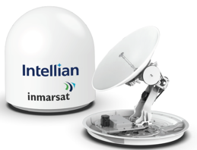
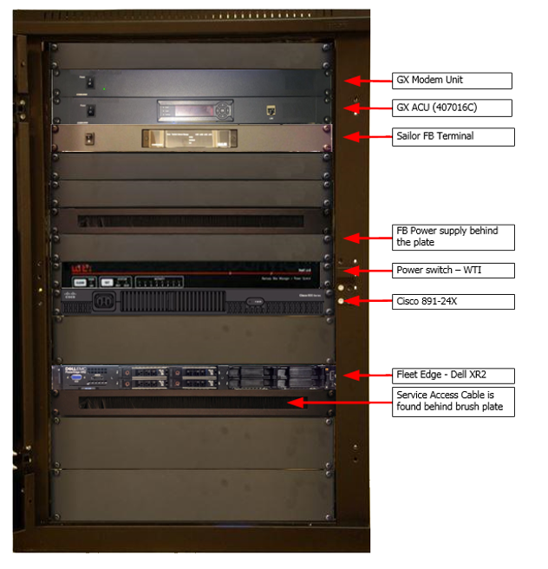
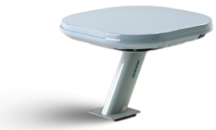
Installation requirements
On board installation
Ka-Band GX
terminal
18-U Rack
A typical NexusWave cabinet contains the following components:
GX Modem unit and ACU
BDU for L-Band backup
Power switch
8 port Ethernet switch
Fleet Edge device
Additional hardware for optional value-added services
LEO
terminal
LTE terminal
(if applicable)
L-Band
terminal

Slide 9
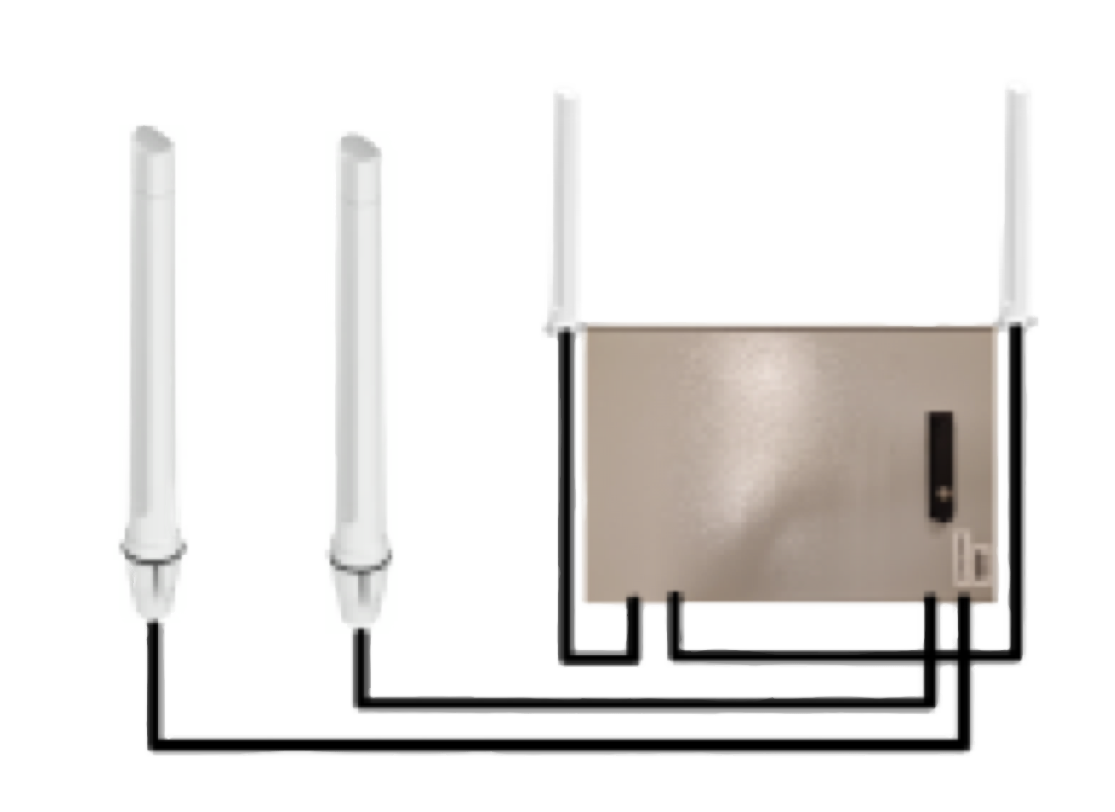
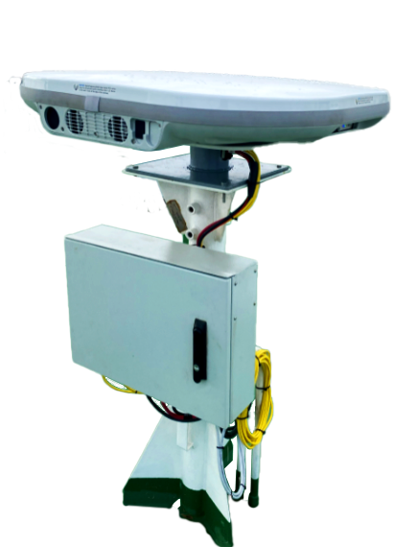
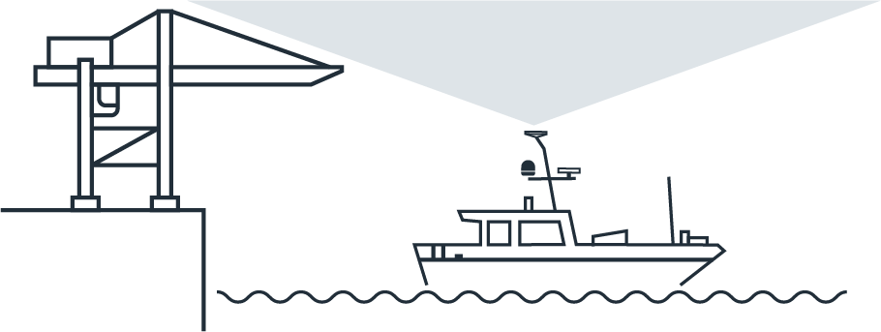
Terminal installation requirements
LEO terminal
LTE terminal
LEO Gen1 terminal
Seaview adapter plate (included in installation kit) can be used to install the LEO Gen1 terminal on a standard VSAT pedestal
Junction box installed in the vicinity of the antenna (max cable length of 2.5m), ideally clamped to the pedestal with the help of an assembly kit provided as part of the installation kit
Clear line of sight required
LTE terminal includes
2x Poynting OMNI-493 as main antennas – to be installed on vessel’s superstructure
2x Poynting OMNI-291 as diversity antennas - to be installed on vessel’s superstructure or LTE cabinet
LTE cabinet w/ Cisco1101+LTE module
LTE cabinet must be as close as possible to the main antennas. 3m vertical separation (minimum 50cm) between main and diversity antennas advised
Clean line of sight
37º-90º elevation (broadside to 53º degrees)
Full 360º Azimuth (broadside to 53º scan)

Slide 10
Fleet Secure Unified Threat Management
Fleet Secure UTM
Fleet Secure UTM provides an added layer of security by inspecting traffic packets to detect malicious traffic. This includes cyber attacks, viruses and attempts to access suspicious websites, ensuring robust protection from threats originating from any endpoint.
INTERNALLY GENERATED MALICIOUS TRAFFIC/ ATTACK VECTORS
EXTERNAL THREATS/ ATTACK VECTORS
NexusWave secure by design network infrastructure
GEO
Fleet Edge Retail
Shore side
infrastructure
Vessel LAN
Fleet Secure UTM
SD-WAN Edge End Point (SEEP)
LEO
SD-WAN Datacenter End Point (SDEP)
SD-WAN Datacenter End Point (SDEP)
WWW
LTE
UTM is positioned at the end of the SNP Tunnel. Takes over to inspect the decrypted data when it enters to the LAN through:
Firewall
IDS/IPS
Intelligent AV
Web/ Application Filtering
Captive Portal
Traffic is encrypted and tunneled from the edge to the destination CDC using SNP tunnels
Top tier ISP-grade firewall security

Slide 11
Inmarsat.com/NexusWave

