Slide 1


NEXUSWAVE
CONNECTED CONFIDENCE

Slide 2

CONNECTIVITY:
A COMPETITIVE ADVANTAGE
From meeting new regulations and implementing new digital technologies to attracting seafarers and enabling crew welfare, demand for data and incredible speeds is growing fast. Having the ability to seamlessly connect across the globe has never been more important.
Always-on connectivity is a genuine competitive advantage, but the available options are complex: myriad packages; patchwork data caps and speeds; mix and match coverage, and unverifiable cyber security.
NexusWave is a maritime communications game-changer built to deliver connected confidence.

Slide 3

Unified multi-dimensional network,
delivering high-speed service,
unlimited data and global coverage.
NEXUSWAVE:
GAME-CHANGING
Maritime’s fastest fully managed
connectivity service delivered by a single
provider and available globally.
Powered by innovative network bonding technology and intelligent orchestration of
multi-dimensional network.
Offering unlimited data, global coverage and ‘secure by design’ infrastructure trusted by global enterprises and governments.
Enabling floating office and floating home.
Backed by the top-tier global technical support and advice from the industry experts.
Providing unmatched connected confidence
for our customers well into the future.
BONDED NETWORK
SERVICE

Slide 4

BRINGING TOGETHER
THE BEST OF ALL NETWORKS
GX
Ka-Band
LEO
LTE
L-band
ViaSat-3
Ka-Band
BYON*
SEAMLESS CONNECTIVITY
delivered via bonded
multi-dimensional networks
NexusWave
FULLY MANAGED CONNECTIVITY SOLUTION enabled by software-defined
intelligent network orchestration
IOT NETWORK
VESSEL
OPERATIONS
CREW NETWORK
UNIQUE OFFERING
rooted in high performance, certainty, consistency and delivering the results our customers expect
CORPORATE NETWORK
CHARTERER OPERATIONS
ViaSat-3 service - expected entry into service in 2025.
*BYON - Bring Your Own Network. Coming soon

Slide 5

UNDERPINNED
BY SD-WAN TECHNOLOGY
SEAMLESS NETWORK BONDING
All high-speed network underlays are active at the same time to maximize the throughput. Unique application of SD-WAN which allow us to bond together data, segregate traffic by network, prioritize between networks and prioritize applications within each network, with no outages caused by network switching.
GX
LEO
LTE
L-band
INTELLIGENT ROUTING
Traffic prioritisation is expanded across all underlays for ‘always-on’ mission critical traffic. Through the application of traffic policies, traffic can be prioritised within the same network (some applications have higher priority than others) or between networks (some networks will have higher priority than others).
Fleet Edge
SD-WAN Powered
SECURITY
Network-wide encryption at vessel level before traffic gets delivered to shore. Traffic secured through ISP (Internet Service Provider)-grade firewall security. Optional enhanced security through our Unified Threat Management value-add service.
Corporate Network
OT
Network
Crew
Network
FUTURE PROOF
Ability to support the addition of new underlays to further increase the service performance, such as ViaSat-3, with no disruption to overlay networks.

Slide 6


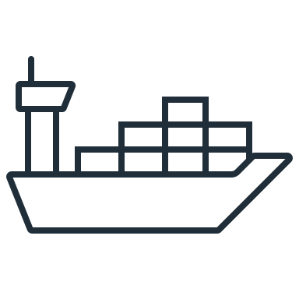

NETWORK BONDING
Combining multiple sources in real time to create a connection of unwavering reliability, speed and consistency
In the middle of the deep sea – plain sailing
In the middle of the deep sea – burst in demand
LEO & VSAT signal lost
Lose line of sight due to port-side obstacle
Busy hotspot areas like ports
KA
LEO
LTE
L-band

Slide 7

CONNECTED CONFIDENCE
1
2
3
4
5
CERTAINTY
Managed performance experience tailored to the customer needs.
Always-on connectivity.
Unlimited data volumes.
Complete transparency on total cost of ownership - no unexpected charges.
Upgrade path to ViaSat-3 network.
HIGH PERFORMANCE
Bonded network capacity leveraging all networks.
Seamless user experience.
Continuous connectivity regardless of vessel’s location and requirements - even in hotspots.
Plans designed to meet customer objectives.
SECURE BY DESIGN
Segregated networks: corporate network, operational technology, crew network.
Top-tier security infrastructure.
Improved security enabled through SD-WAN with encrypted overlays.
Additional level of value-added services to further enhance security.
GLOBAL COVERAGE
Global coverage from underlying networks.
Management of
underlays for the best performance, even
in hotspots.
GLOBAL SUPPORT
Maintenance and support anywhere
in the world.
Enabled by knowledge
and experience of global network of experts
and engineers.

Slide 8

FLOATING OFFICE AND HOME
Designed to provide unparalleled experience in line with evolving customer needs
FLOATING OFFICE
FLOATING HOME
Powers cloud
computing
for office, ERP,
and remote
IT management,
whilst being beyond
security compliant.
Provides a seamless user experience for crew welfare usage.
Provides your crew with a connectivity experience similar to what they expect at home.
Inter-connected ecosystem
Enabling digitalization, decarbonization and crew welfare.

Slide 9
Section 2 Solution To Situation
Select a plan that enhances your business, operational, and crew experience - whether by powering mission-critical applications, relaying vessel data back to shore, or keeping your crew connected.
TAILORED TO
CUSTOMER
We’ll work closely with you to make sure the selected plan meets your requirements and priorities.
NEEDS
From upgrading speeds to finding new ways to enhance day-to-day operations, NexusWave will continuously evolve along with your requirements and growth.

Slide 10
Section 2 Solution To Situation
SUPPORTED
NexusWave partners you with the most experienced team in the maritime industry.
GLOBALLY BY
The Inmarsat team are on hand 24/7, 365 days a year, making sure you receive top-level technical support and advice, plus a total commitment to the constant improvement of your service.
THE INDUSTRY
Self Serve Portals offer a responsive, intuitive dashboard for swift decision-making and makes it easier to monitor connection, data usage and the location of your vessels.
EXPERTS
We’re here to make sure that connectivity in your business goes from strength to strength, ensuring ongoing optimisation and all relevant service upgrades.

Slide 11

Section 2 Solution To Situation
NexusWave offers top-tier security. Wherever your connection is in our technical infrastructure, it’s monitored, managed and protected 24/7. Providing complete peace of mind.
A SECURE
CONNECTION
Operational, business, crew, charterers networks are split into dedicated pipelines so any threats are isolated and can’t move across operational areas.
FOR PEACE
Data will flow encrypted through our secure-by-design infrastructure, which is audited by the IMO and supports you to go beyond maritime cybersecurity requirements.
OF MIND
Traffic encrypted independent from the underlay and protected by ISP-grade firewall security offering the next level of cyber resilience.

Slide 12
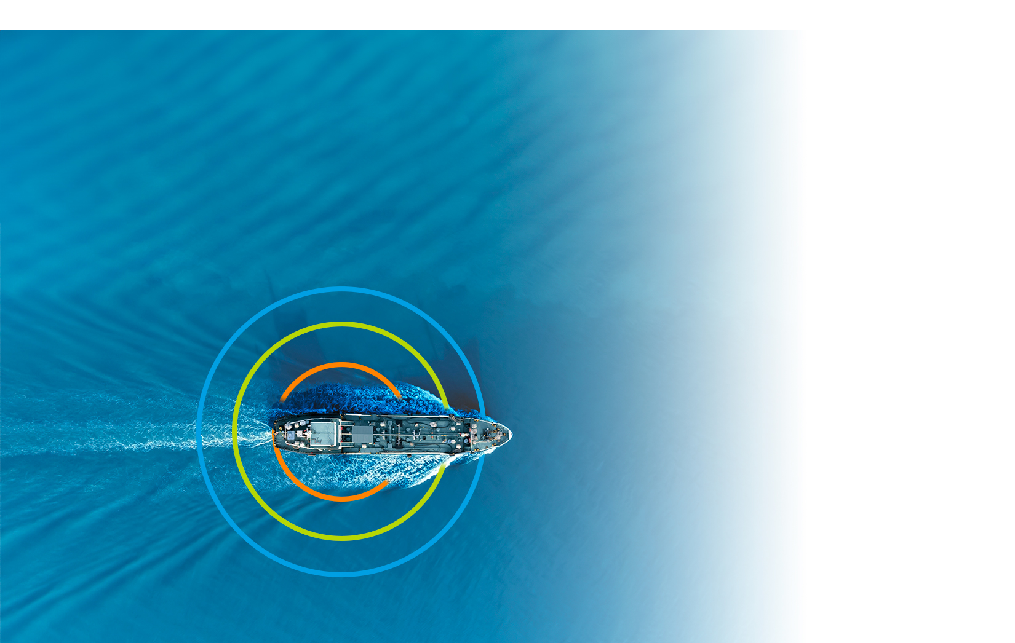

MANAGED CONNECTIVITY
FOR THE EXPERIENCE YOU REQUIRE
Managed performance levels set according to your requirements, priorities and operational needs, aimed to provide seamless and secure experience. Select a plan that enables your business, operational and crew experience. From confidence to power mission-critical applications to relaying vessel data back to shore, to keeping your crew connected.
OPERATIONAL EXPERIENCE
Aligned with the IMO 2021 Cybersecurity guidelines, this segregated network is exclusively dedicated to operational traffic, such as vessel monitoring, CCTV, remote monitoring, and telemedicine applications.
BUSINESS EXPERIENCE
Committed to meeting the business requirements of vessel operations, NexusWave’s business network enables and optimises the use of corporate and collaboration applications.
CREW EXPERIENCE
Designed to enhance crew welfare the service is optimised for seamless access to services like email, web browsing, social media, messaging, and streaming.

Slide 13
SELECT A PLAN FOR THE EXPERIENCE YOU REQUIRE
NexusWave Plans
Select
Extra
Prime
Advanced
Key features
Unlimited data – no overage | ● | ● | ● | ●
Fully managed service – hardware & future upgrades included | ● | ● | ● | ●
Unique network bonding – delivers fast & consistent speeds | ● | ● | ● | ●
Reliable service – L-band back-up with 99.9% uptime | ● | ● | ● | ●
Network-wide encryption & firewall | ● | ● | ● | ●
Business experience
Segregated business network – prioritised over operational & crew traffic. Fast download of large data files | ● | ● | ● | ●
Supports remote IT management | + collaborative cloud programs (e.g. Office 365) | + collaborative cloud programs (e.g. Office 365) | + concurrent collaborative cloud programs + enterprise apps | + concurrent collaborative cloud programs + enterprise apps
Enhanced port & coastal connectivity (LTE) |  | ● | ● | ●
Operational experience
Segregated operational network – prioritized over crew traffic | ● | ● | ● | ●
Optimized for vessel monitoring (CCTV, remote survey, IOT) |  | ● | ● | ●
Enhanced port & coastal connectivity (LTE) |  |  | ● | ●
Crew experience
Configured for messaging, web, banking, training, social, gaming, streaming, video calling | ● | ● | ● | ●
Optimized for | 5 concurrent streams | 5 concurrent streams | 10 concurrent streams | 15 concurrent streams
Enhanced port & coastal connectivity (LTE) |  |  |  | ●
Enabled by
Speed, downlink | Up to 160Mbps (60cm GX antenna) Up to 180Mbps (1m GX antenna) | Up to 200Mbps (60cm GX antenna) Up to 230Mbps (1m GX antenna) | Up to 230Mbps (1m GX antenna) | Up to 230Mbps (1m GX antenna)
Guaranteed speed with 95% availability (downlink/ uplink) | 256/128kbps | 512/256kbps | 1,024/512kbps | 2,048/1,024kbps
Care Programme (upgradeable) | Basic | Basic | Standard | Premium
Preferential rate on Unified Threat Management (UTM) service |  |  | ● | ●
Premium Customer Support SLA |  |  |  | ●

Slide 14
NexusWave empowers you to streamline your connectivity to the power of one. One unified solution, one contract, one consistent experience, all in one, flat monthly fee.
No need to coordinate multiple connectivity types. No need to monitor the coverage and capability
of different services. No need to worry about
where you will be in five years’ time.
With NexusWave and our expert Inmarsat team by your side, you can confidently navigate to the future.
THE
POWER
OF ONE

Slide 15
FUTURE
NexusWave is underpinned by one guiding principle: continuous managed improvement.
PROOF
Every business has pain points. Share yours, and together we will continuously improve your experience.
Because, while solving today’s problems is a priority, we should always look to the future.
To see what challenges and opportunities are arriving tomorrow, next year, and in the years to come.
NETWORK
NexusWave is a future-proof, scalable solution - we’re committed to a program of continuous service improvement with an upgrade path. This includes our next-generation ultra-high capacity high-speed ViaSat-3 Ka-band service, following expected entry into service in 2025.

Slide 16
THANK YOU

